Slide 1
Process Description and Control
Chapter 3

Slide 2
What have we learnt so far?
A computer system consists of a collection of hardware resources
Operating systems are designed to make it convenient for the users to use a computer system
Applications are usually written to perform some task
Applications are written without taking into account the underlying hardware
An operating system is an interface between the user and the hardware that allocates system resources to user applications

Slide 3
Multiprogramming
OS allocates system resources to multiple programs
The processor is switched among different programs – all appear to be progressing
Allows efficient utilization of processor and I/O devices

Slide 4
A process
A process is a program in execution
Associated with a process is
the program it is executing
The program code may be shared by different processes
data
A process has a status that includes PC, processor registers

Slide 5
Process
A process is characterized by its
Identity
State
Priority
Program counter
Memory management information
Context data
I/O status information
Accounting information

Slide 6
Process Control Block
A data structure that contains information about a process
Each process has a separate process control block (PCB)
PCB is also known as Task Control Block
PCB is a repository of information for a process. It varies from process to process
Created and managed by the OS
It is a key tool for supporting multiple processes

Slide 7
Process States
Two state model
Running
Not running
DISPATCHER: A program that switches processor from one process to another
Dispatch
Enter
Not Running
Exit
Running
Interrupt

Slide 8
Queuing Diagram
Queue
Dispatch
Processor
Exit
Interrupt

Slide 9
Process Creation
New job
Interactive logon
In response to a service request
Spawned by a running process
Spawning process is called the parent process
Spawned process is called the child process

Slide 10
Process Termination
Need a means for a process to indicate its termination
A batch job usually includes a HALT or STOP instruction or an explicit OS service call for termination
An interactive job is terminated when a user logs off or quits an application
A process may terminate normally or abnormally
Normal termination: The process executes an explicit call for termination
Abnormal termination: OS terminates the job

Slide 11
Five-state Process Model
Process states
Exit
Ready
Dispatch
Admit
Complete
Timeout
New
Event occurs
Run
Event wait
Wait

Slide 12
Using two Queues
Ready Queue
Dispatch
Processor
Release
Admit
Timeout
Blocked queue
Event occurs
Event wait

Slide 13
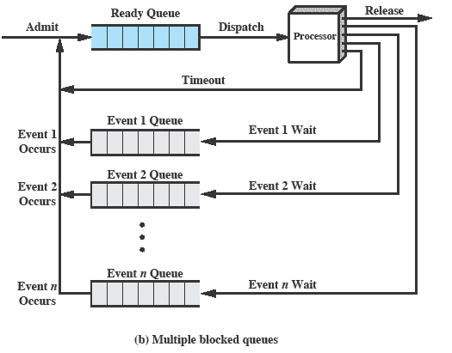
Multiple blocked queues

Slide 14
Suspended Processes
An addition of a suspend state is necessary in some cases.
One or more processes are put in suspend state if all processes in main memory are waiting for some event to occur.
The suspended process is placed on the backup storage (disk) and one of the old suspended processes or a new process is brought into memory to keep CPU busy
Swapping: The process of removing a process from main memory and replacing it with another from the disk

Slide 15
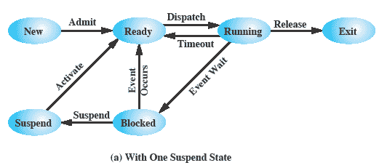
One Suspend State

Slide 16
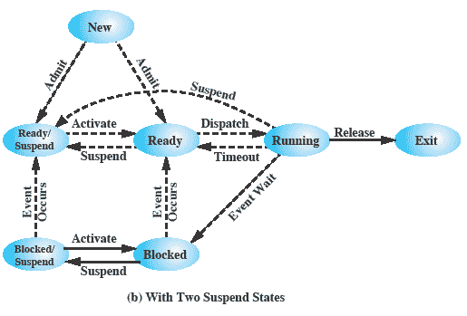
Two Suspend States

Slide 17
Characteristics of a suspended process
Process is not in memory
Process not available for execution immediately
A parent process may place its child process in a suspended state -- such a process may or may not be waiting for an event
Only the process (OS or parent) that suspended a process can re-activate the process

Slide 18
Process Suspension
OS needs to release main memory
OS determines that the process is causing some problem
Interactive users may suspend execution of a process for debugging purposes
Periodic processes are suspended till their next time period
A parent process may suspend a child process for synchronization

Slide 19
OS Control Structure
OS controls events within a system
Scheduling
Executing
Allocating resources
Responding to process requests
OS needs to keep track of current status of each process
OS maintains tables

Slide 20
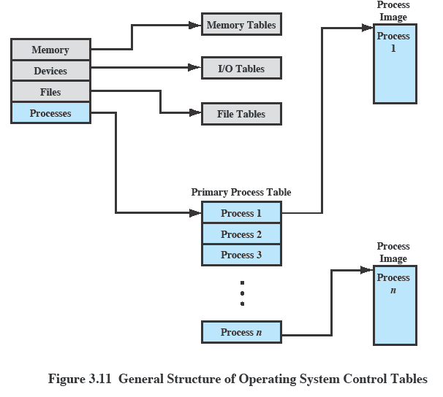
OS Control Tables

Slide 21
Memory Tables
Keeps track of main and secondary memory
In swapping or virtual memory systems, processes maintained on secondary memory
Information in memory tables includes the following
Main memory allocated to process
Secondary memory allocated to processes
Protection attributes of allocated memory
Information needed to manage virtual memory

Slide 22
Device or I/O Tables
Keeps track of all I/O devices
I/O device is working or not working, free or allocated to some process
For an I/O operation
The status of the I/O operation
Main memory location involved in the I/O operation

Slide 23
File Tables
Used for file management
Tables include the following information
File ID
Location on secondary memory
Current status
File attributes
Files may be managed by a File Management System

Slide 24
Process Tables
Maintained to keep track of a process
Process tables contain reference to memory, I/O devices, files, etc.
Tables are maintained in memory
Subject to memory management rules

Slide 25
Process Control Structure
OS needs to know
Location of the process
Process attributes (Process ID, process state, process priority, etc.)

Slide 26
Process control structures
Process location
Parts of the memory where the program being executed by the process is located
Stack that is used to keep track of procedure calls and parameter passing between procedures
Process image: collection of program, data, stack, and its attributes
Image location depends on the memory management scheme

Slide 27
Process Attributes
Process Identification
Process ID
ID of the parent
User ID
Process State Information
User accessible registers
Control and status registers
PC, condition codes, status information (interrupt enable/disable flags, execution mode)
Stack pointers

Slide 28
Process Identification
Unique numeric value
Used for mapping appropriate tables associated with the process
Used for inter-process communication
Used for keeping track of descendants and ancestors
Many of the tables used by OS use pid to cross reference process tables

Slide 29
Process State Information
Consists of the contents of processor registers
User visible registers
Control and status registers
Stack pointers
Process Status word (PSW): contains condition codes and other status information
EFLAGS register on x86 is an example of a PSW

Slide 30
X86 EFLAGS Register
A 32-bit register
ID
VIP (virtual interrupt pending)
VIF (virtual interrupt flag)
AC (alignment check)
VM (virtual 8086 mode)
RF (resume flag)
NT (nested task flag)
IOPL (I/O privilege level)
OF (overflow flag)
DF (direction flag)
IF (interrupt enable flag)
TF (trap flag)
SF (sign flag)
ZF (zero flag)
AF (auxiliary carry flag)
PF (Parity flag)
CF (carry flag)

Slide 31
Process Control Information
Additional information needed by the OS to control and coordinate the various active processes
Scheduling and state info
Data structuring
Inter-process communication
Process privileges
Memory management
Resource ownership and utilization

Slide 32
Process image in virtual memory
Process control block
Process Identification
Process state information
Process control information
User stack
User address space
Private
Shared

Slide 33
Role of Process Control Block
The most important data structure of OS
Contains all of the info about the process
PCBs are read and modified by different modules of OS
Defines the state of OS
Difficulty is not access, but protection
A bug could damage PCBs
Could destroy system’s ability to manage the affected process
A change in structure could affect a number of OS modules

Slide 34
Modes of Execution
User mode
A mode in which user programs are executed
Has less privileges
Cannot execute privileged instruction
Memory access restricted to user address space
System mode
Also referred to as a kernel mode, supervisor mode, monitor mode, or control mode
More privileged mode
Can execute privileged instructions
Has full access to memory

Slide 35
Typical Functions of an OS Kernel
Process management
Process creation/termination; scheduling/dispatching, process switching, synchronization, inter-process communication, management of PCBs
Memory
Allocation of address space; swapping; page/segment management
I/O management
Buffer management
Allocation of I/O channels and devices
Support Functions
Interrupt handling
Accounting
monitoring

Slide 36
Process creation
OS creates processes to execute user programs
A process may request creation of another process
When a process is created, OS
Assigns a unique pid to the new process
Allocates space for the process
Initializes the PCB
Sets appropriate linkages
Creates or expands other data structures

Slide 37
Process Switching
Process switching occurs any time OS gains control back from the running process
Possible events giving OS control are
Interrupt
External to the execution of the current instruction
Reaction to an asynchronous external event
Trap
Associated with the execution of the current instruction
Handling of an error or an exception condition
Supervisor call
Explicit request
Call to an OS function

Slide 38
System Interrupts
Interrupts
Due to some sort of an event that is external to and independent of the currently running process
Clock/timer interrupt
Time slice: maximum amount of time that a process can execute before being interrupted
I/O interrupt
Memory fault
Trap
An error or exception condition generated within the currently running process
OS determines if the condition is fatal
Action will depend on the nature of the error
If condition is fatal, process moved to the Exit state; a process switch occurs

Slide 39
Mode Switching
An instruction has the following stages
Fetch stage
Execution stage
Interrupt checking
During interrupt checking,
If no interrupts are pending, system proceeds to the fetch stage of the next instruction
If interrupts are pending, set the PC to the starting address of an the interrupt handling routine
Switch from user mode to kernel mode – interrupt processing routine may include privileged instructions

Slide 40
Changing a process state
If a process has to move from running state to another state, need to take following steps
Save context of the processor
Update PCB of the running process
Move PCB to the appropriate queue
Select another process to run
Update PCB of the selected process
Update memory management data structure
Restore context of the selected process

